Slide 1
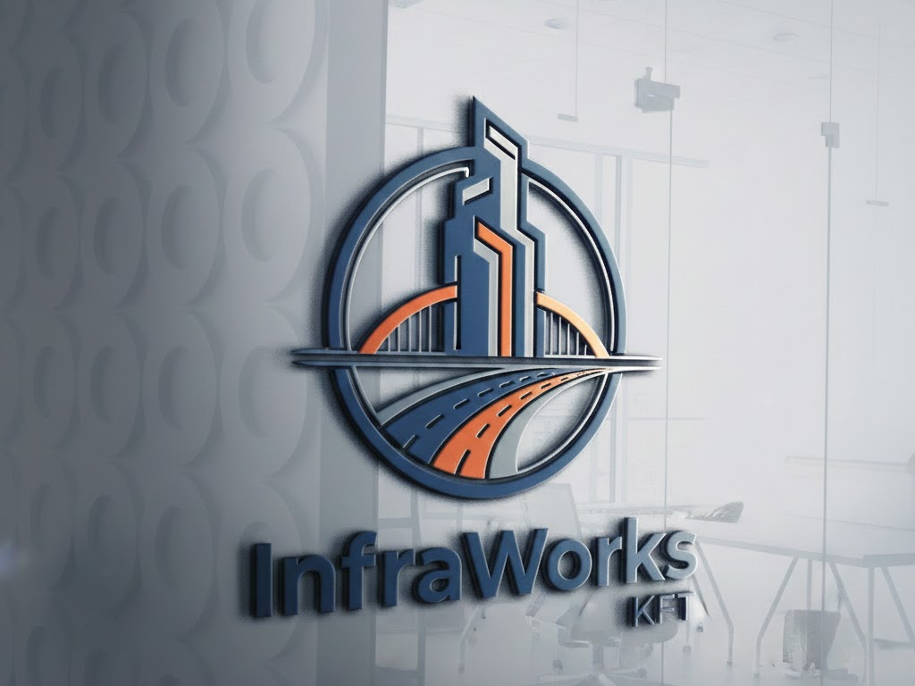

InfraWorks KFT
Project
Team Members:
Tóth Richárd (PM)
Schäfer Kristóf,
Date: 2026

Slide 2
The Project Vision
Structure: Háromszintes (Core, Distribution, Access) hierarchia.
Redundancia: Dupla ISP, redundáns tűzfalak és Core switches.
Segmentation: Floor-based bontás és dedikált DMZ a szervereknek.
Technológiák: HSRP for fault tolerance, LACP for bandwidth.

Slide 3

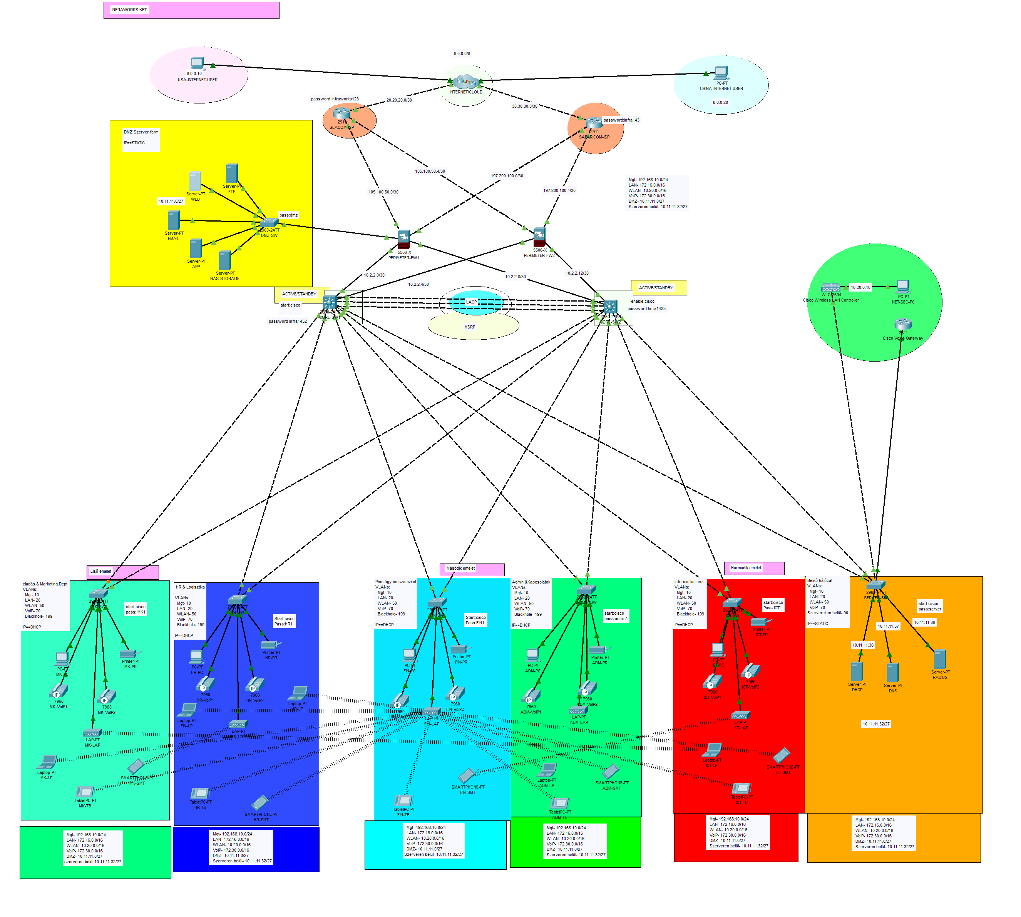
A Projekt complete overview
1. Central Security and Core Layer
Internet & DMZ: Isolated server farm (Web, FTP, Email, DNS).
Redundancy: 2x ASA Firewall and Core Routers.
Technologies: Magas availability high (HSRP, LACP).
2. Logical Segmentation (VLAN & Floors)
Ground Floor (Zöld/Kék): Marketing, HR, Logistics.
1. Floor (Light Blue): Finance, Administration.
2. Floor (Piros): IT / IT.
Server Room (Orange): Central DHCP, DNS and RADIUS.
3. Device Pool and Connectivity
Endpoints: PC, Laptop, IP-phone, Mobil devices.
WLAN: WLC managed Lightweight Access Points (LAP).
Management: Isolated LAN and WiFi IP-ranges.

Slide 4
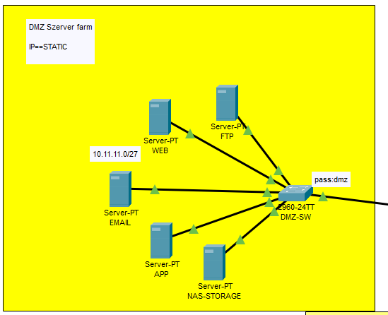
2. DMZ (Demilitarized Zone)
DMZ Network Summary
Function: Isolation of public servers
from the internal network.
Device: Cisco 2960 (Dedicated DMZ-
SW).
Network: 10.11.11.0/27 (Mask:
255.255.255.224).
Range: 10.11.11.1 – 10.11.11.30.
Purpose: ​ Public service (WEB, EMAIL, FTP, APP, NAS) safe isolation from the internal network.

Slide 5
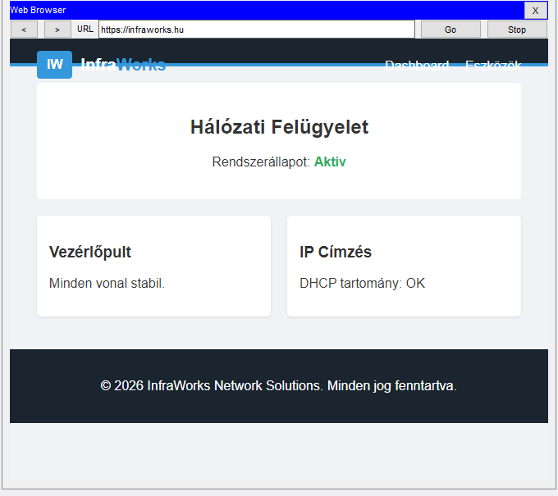
WEB: Website (HTTP/S).
EMAIL: Correspondence (SMTP/IMAP)
FTP: File transfer (SFTP).
APP: Business apps (API).
NAS-STORAGE: Central storage (NFS/SMB).
Security: VLAN-based segmentation + Firewall blocking towards the internal network.
Servers

Slide 6
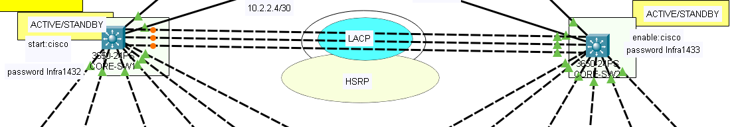
"Brain" of the network or Core network redundancy and
control
Devices: 2 Cisco 3560 Multilayer Switches (CORE-SW1, CORE-SW2).
Applied Technologies:
LACP (EtherChannel): Aggregation of multiple links for high bandwidth.
HSRP: Virtual Default Gateway (Gateway) for continuous operation.
WLAN Controller (WLC): Central unit for managing all Wi-Fi points on the floor.

Slide 7
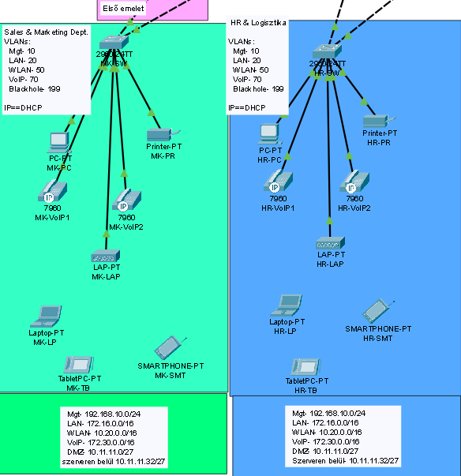
First floor (Blue & Green block) Sales, HR and Logistics
Departments:
Sales & Marketing, HR&Logistics.
Endpoint devices:
Wired PCs and Laptops.
Network printers (MK-PR, HR-PR).
Mobile devices (Tablets, Smartphones).
Communication: IP phones at every desk (VoIP
network).
Wi-Fi: Dedicated access points (Access Points).

Slide 8

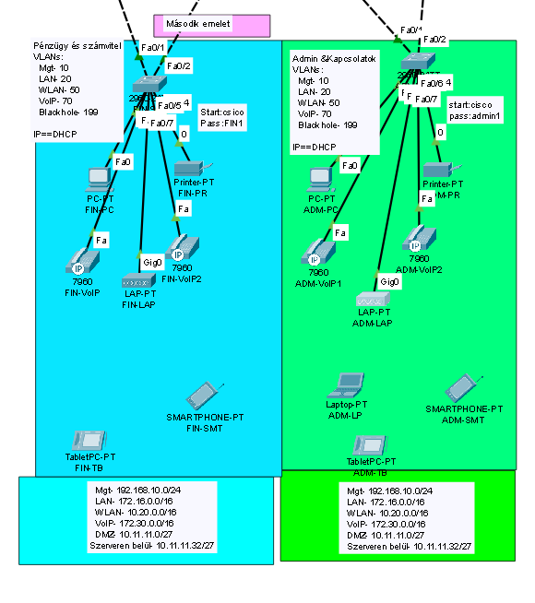
Departments:
Finance & Accounting, Admin & Relations.
Structure:
The first floor is an identical structure (standardized deployment).
Network:
VLAN-based segmentation
in data protection.
Tools:
Dedicated Access Switches (FIN-SW, ADM-SW)
handle connectivity to Core.
2. Floor (Light Blue/Light Green

Slide 9
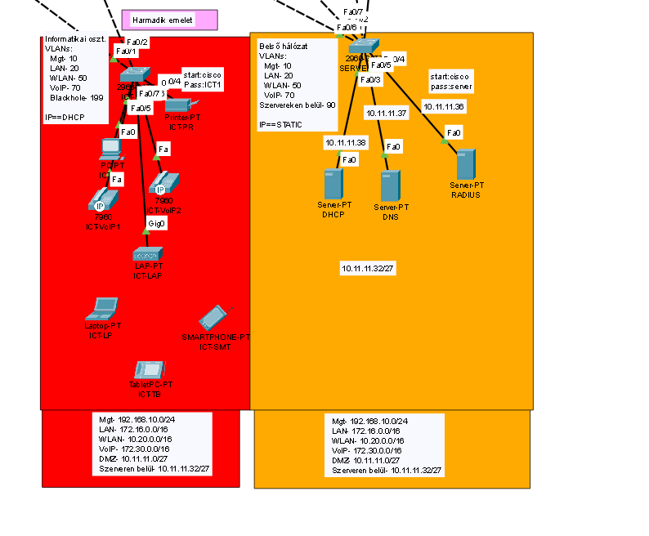
Information technology department (ICT): Operational supervision and development.
Internal Network Services (Server-SW):
DHCP Server: Automatic IP address assignment to clients.
DNS Server: Internal and external name resolution.
RADIUS Server: User authentication and network security (AAA).
Third floor and IT center (IT Department and Internal Servers)

Slide 10
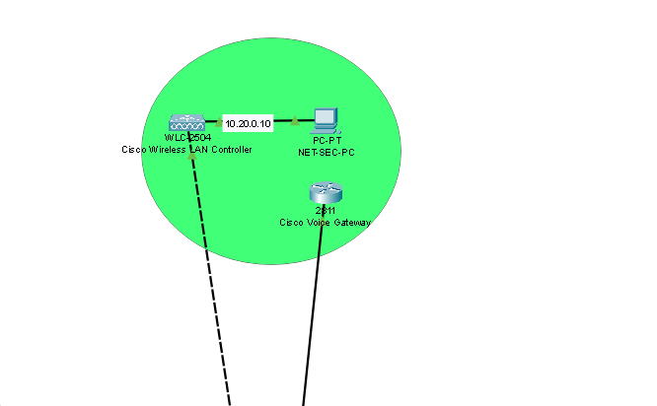
Management Network​
(Green Zone)
NET-SEC-PC (10.20.0.10): Central
administrative workstation for network
supervision.
WLC-2504: Cisco Wireless LAN Controller a
corporate Wi-Fi network and APs central
to control.
2811 Voice Gateway: Cisco router for voice
(VoIP) traffic and the telephone exchange
to serve.
This zone provides protection from the DMZ and the internal network
separated, protected access to the network
infrastructure (WLAN, Voice, Security)
to configure.

Slide 11
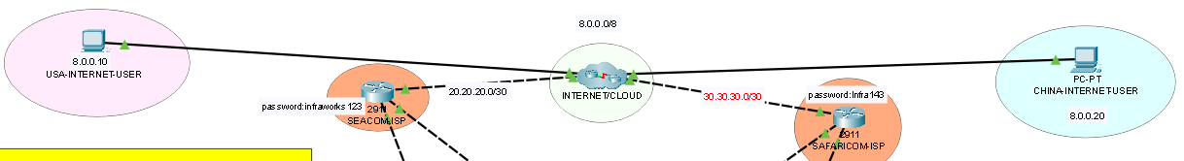
External Connectivity and Internet (INTERNET/CLOUD)
Central Cloud: The network is connected to the outside world through the domain 8.0.0.0/8.
USA-INTERNET-USER (8.0.0.10): Access for remote US client.
CHINA-INTERNETUSER (8.0.0.20): Access for remote Chinese client.
Connections: The central routers (for example on subnets 20.20.20.0/30 and 30.30.30.0/30
via) provide traffic control between the sites and the Internet.

Slide 12
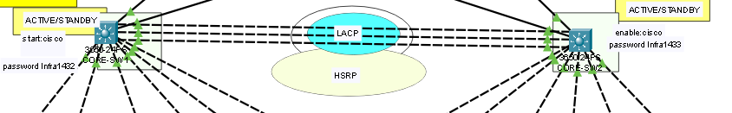
The Core Network (The "Heart of the Network")
The two large switches (CORE-SW1 and CORE-SW2) do the heavy lifting.
HSRP (Duplication): It's like a spare wheel. If one of the switches
breaks down, the other one immediately takes its place, and the workers don't even notice
they take the shutdown.
LACP (Lasing): Multiple cables are connected between switches to
data traffic should be faster, and if a cable breaks, stay
another way for the data.

Slide 13
Network virtual machines
we created Oracle VirtualBox
using a program called

Slide 14
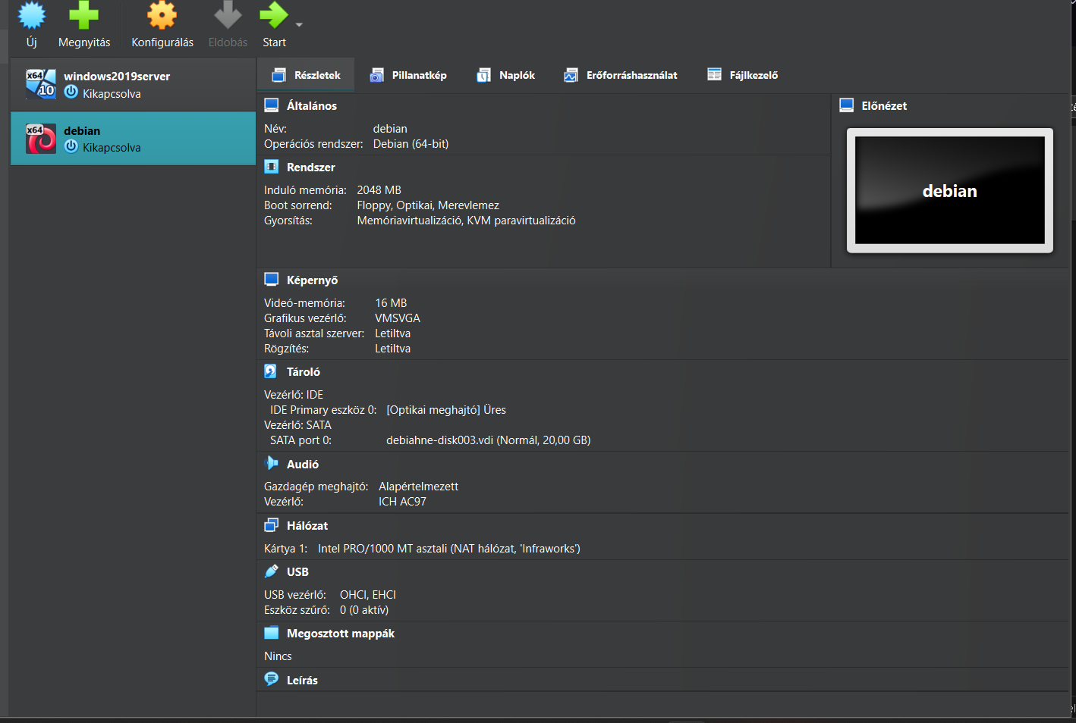
Virtual Machines Used
Windows Server 2019
System: Windows Server-based environment with a graphical interface.
Network setting: Static IP address for reliable accessibility.
Debian
System: Debian Linux-based server installation with a custom user account.
Network setting: Static IP address configured for reliable accessibility.

Slide 15
Active Services:
Web Server: Apache installation HTTP (unencrypted) and
with support for secure HTTPS (encrypted) protocols.
File Sharing: Samba service configured for cross-platform
data access.
Data Protection: Setting up automated system backup
using a cron timer.

Slide 16

Windows Server 2019 Infrastructure
Installation: Administrative environment and IPv4 configuration.
Directory: Active Directory és DNS szerviz telepítése.
DHCP: Automatic IP address assignment to clients.
Resources: Centralized file and printer sharing.
Security: Backup schedule configuration.

Slide 17
Debian/Linux Server
System Environment: Debian OS installation with a custom user account and NAT network integration.
Network Basics: Static IPv4 address configuration for fixed and reliable service access.
Web Service: Apache web server implementation with support for HTTP and secure HTTPS protocols.
File Management: Samba service installation for seamless data exchange between Linux and Windows platforms.
System Security: Creating an automated data backup process using a cron task scheduler.

Slide 18
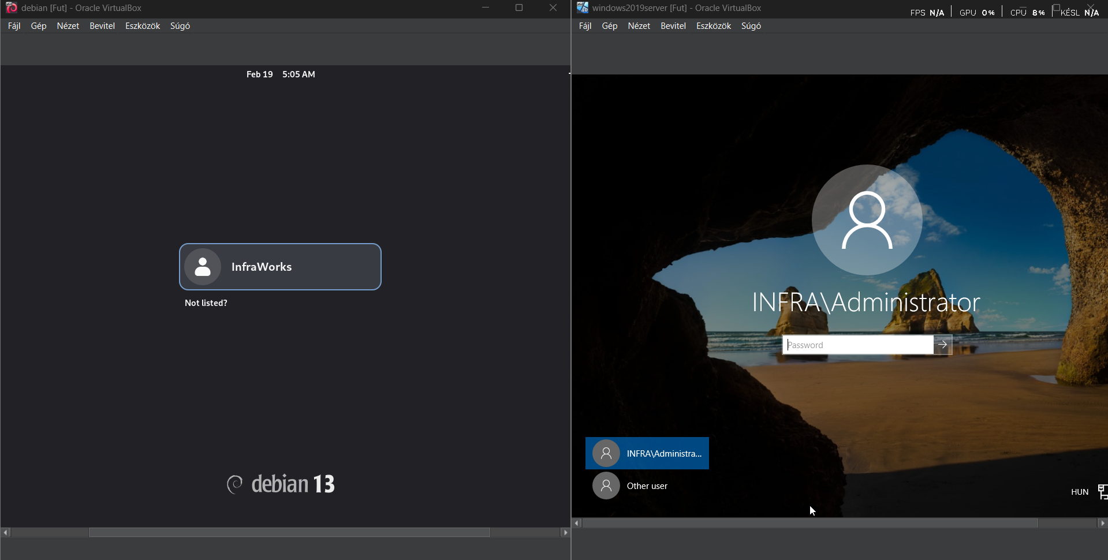
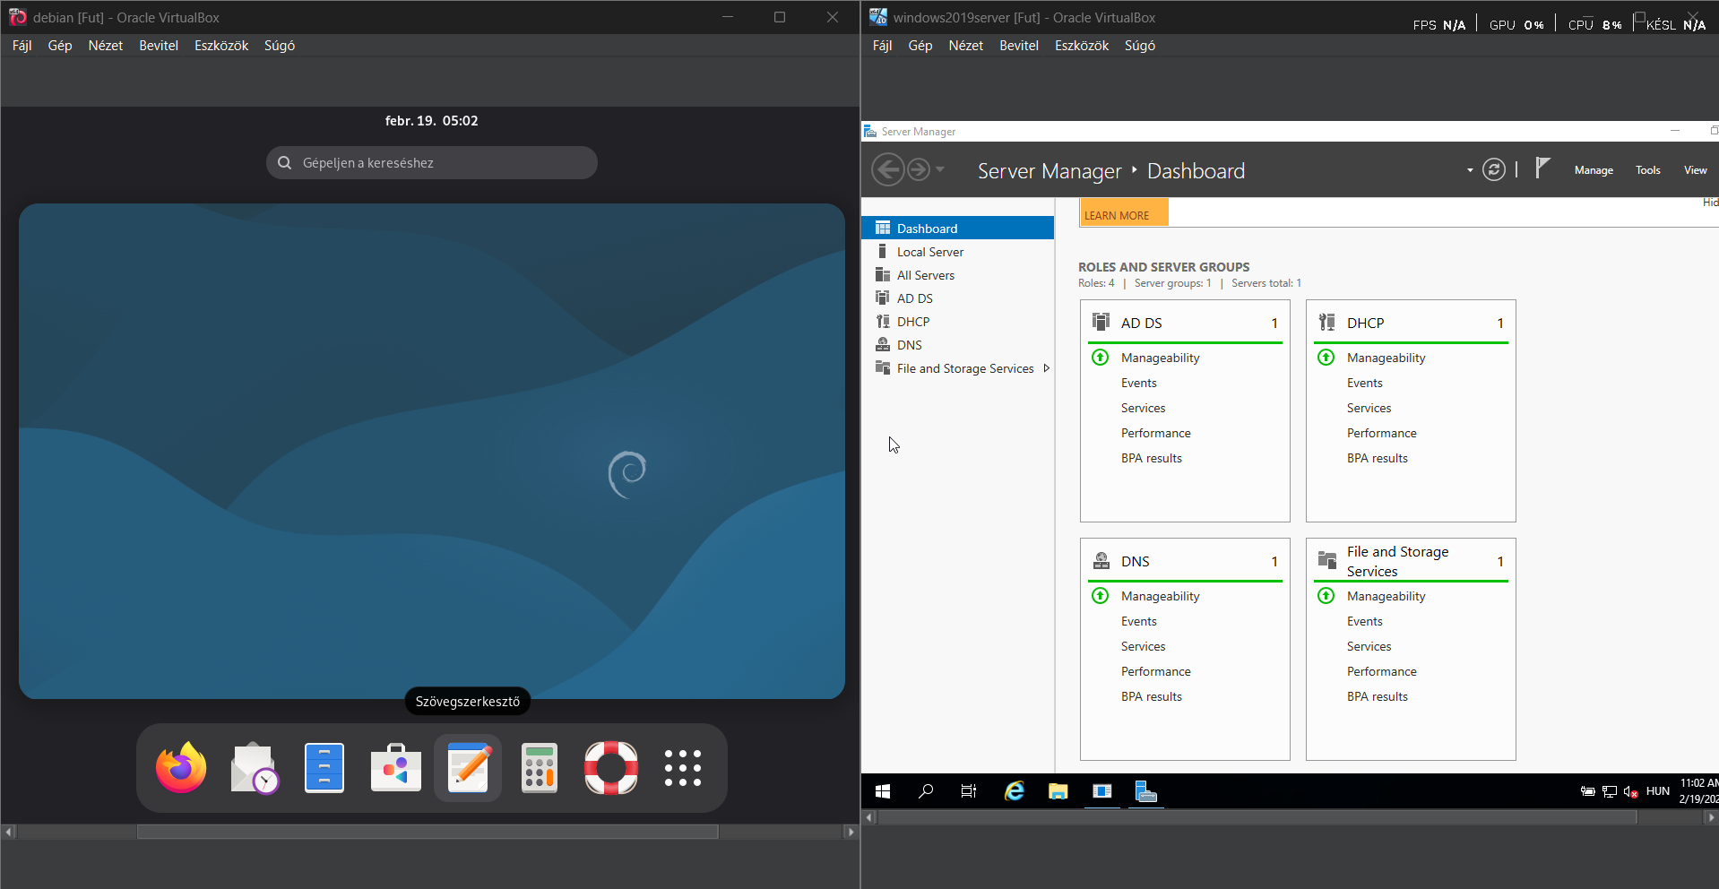
Network Virtual Machines in Action
Windows
Debian

Slide 19
GIT – Version Control
What is this? Software that saves files differently
states.
What is it good for?:
Traceability: Everything changes and person
also logged. there is.
Rollback (Rollback): Error you can revert to
for an earlier, working version.
Teamwork: Multiple people can work on the
same a project without overwriting each
other's work.

Slide 20
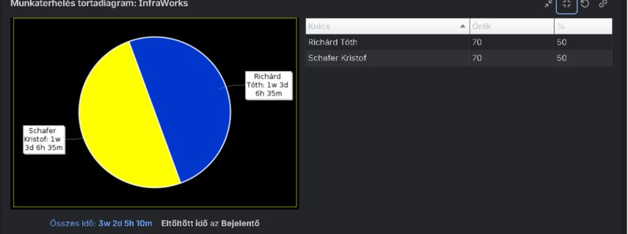
JIRA – Project Management and Issue Tracking
What is this? A task management and
process tracking framework.
How did we use it?
Assignment of tasks: Scheduling of
work items (e.g. cabling, procurement,
installation).
Error tickets (Tickets): Recording and
managing problems arising during
implementation.
Status Tracking: Monitoring progress
using "To Do", "In Progress" and
Using "Done" columns.
Deadlines: Meeting milestones and
delivery dates.

Slide 21
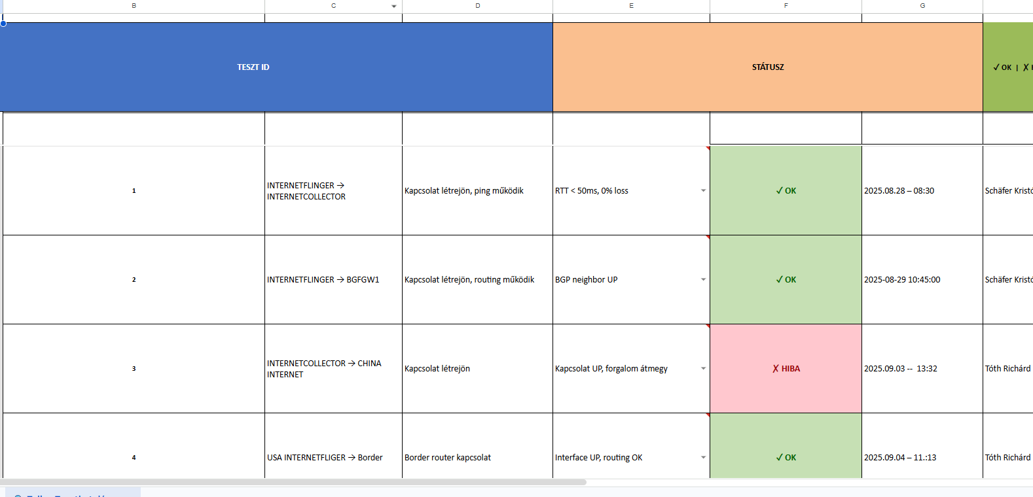
Testing

Slide 22
Thank you for your attention!

